Slide 1
Course Business
First lab today—materials are on Canvas
Canvas: Modules → Week 2.2
Can download to your computer before class
Readings now available on Canvas
Notes:
Did change it yesterday
Longitudinal sixth graders, causal learning
Marketing - firm-brand-store-individual
½ R, MATLAB (also Python)

Slide 2
Week 2.2: Data Processing in R
Filtering
Basic Filtering
Advanced Filtering
Mutate
Basic Variable Creation and Editing
if_else()
Variable Types
Other Functions & Packages

Slide 3
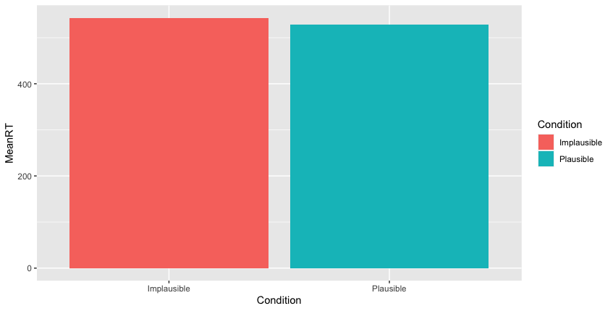

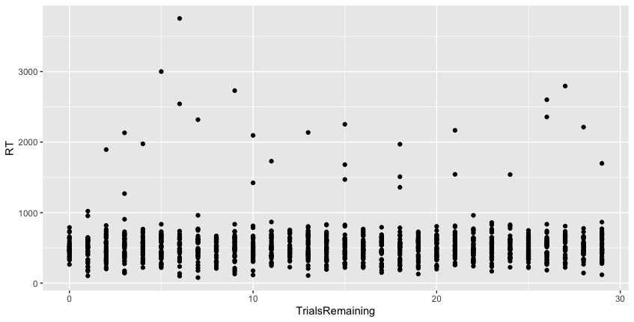
Filtering Data
We didn’t see a big difference between conditions
But, some RTs look like outliers—we may want to exclude them

Slide 4
Filtering Data
Often, we want to examine or use just part of a dataframe
filter() lets us retain only certain observations
experiment %>% filter(RT < 2000) %>% group_by(Condition) %>% summarize(M=mean(RT))
Inclusion criterion: We want to keep RTs less than 2000 ms
As we saw last time, this gets the mean RT for each condition

Slide 5

Filtering Data
Often, we want to examine or use just part of a dataframe
filter() lets us retain only certain observations
experiment %>% filter(RT < 2000) %>% group_by(Condition) %>% summarize(M=mean(RT))
Inclusion criterion: We want to keep RTs less than 2000 ms

Slide 6
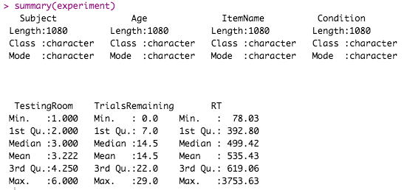
Filtering Data
This only temporarily filtered the data
If we want to

Slide 7
Filtering Data
This only temporarily filtered the data
If we want to run a lot of analyses with this filter, we may want to save the filtered data as a new dataframe
experiment %>% filter(RT < 2000) -> experiment.filtered
-> is the assignment operator. It stores results or data in memory.
Name of the new dataframe (can be whatever you want)

Slide 8
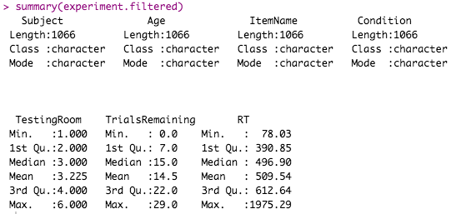
Filtering Data
This only temporarily filtered the data
If we want to run a lot of analyses with this filter, we may want to save the filtered data as a new dataframe

Slide 9
Writing Data
Note that this is just creating a new dataframe in R
If you want to save to a folder on your computer, use write.csv():
write.csv(experiment.filtered, file='experiment_filtered.csv')
Notes:
CHECK THE MAX RT. Note this is a subset of the ORIGINAL dataframe

Slide 10
Filtering Data
Why not just delete the bad RTs from the spreadsheet?
Notes:
CHECK THE MAX RT. Note this is a subset of the ORIGINAL dataframe

Slide 11
Filtering Data
Why not just delete the bad RTs from the spreadsheet?
Easy to make a mistake / miss some of them
Faster to have the computer do it
We’d lose the original data
No documentation of how we subsetted the data
Notes:
CHECK THE MAX RT. Note this is a subset of the ORIGINAL dataframe

Slide 12
Week 2.2: Data Processing in R
Filtering
Basic Filtering
Advanced Filtering
Mutate
Basic Variable Creation and Editing
if_else()
Variable Types
Other Functions & Packages

Slide 13
Filtering Data: AND and OR
What if we wanted only RTs between 200 and 2000 ms?
experiment %>% filter(RT >= 200 & RT <= 2000)
| means OR:
experiment %>% filter(RT < 200 | RT > 2000) -> experiment.outliers
Logical OR (“either or both”)

Slide 14
Filtering Data: == and !=
Get a match / equals:
experiment %>% filter(TrialsRemaining == 0)
Words/categorical variables need quotes:
experiment %>% filter(Condition=='Implausible')
!= means “not equal to”:
experiment %>% filter(Subject != 'S23’)
Drops Subject “S23”
Note DOUBLE equals sign

Slide 15
Filtering Data: %in%
Sometimes our inclusion criteria aren't so mathematical
Suppose I just want the “Ducks” and “Panther” items
We can check against any arbitrary list:
experiment %>% filter(ItemName %in% c('Ducks', 'Panther'))
Or, keep just things that aren't in a list:
experiment %>% filter(Subject %in% c('S10', 'S23') == FALSE)

Slide 16
Logical Operators Review
Summary
> Greater than
>= Greater than or equal to
< Less than
<= Less than or equal to
& AND
| OR
== Equal to
!= Not equal to
%in% Is this included in a list?

Slide 17
Week 2.2: Data Processing in R
Filtering
Basic Filtering
Advanced Filtering
Mutate
Basic Variable Creation and Editing
if_else()
Variable Types
Other Functions & Packages

Slide 18

Mutate
The last tidyverse function we’ll look at is mutate()
Add new variables
Transform variables
Recode or rescore variables
Notes:
Log(1) = 0
Log(2) = 0.69
Log(3) = 1.10

Slide 19
Mutate
We can use mutate() to create new columns in our dataframe:
experiment %>% mutate(ExperimentNumber = 1) -> experiment
We are creating a column named ExperimentNumber, and assigning the value 1 for every observation
Then, we need to store the updated data back into our experiment dataframe
Notes:
Log(1) = 0
Log(2) = 0.69
Log(3) = 1.10

Slide 20
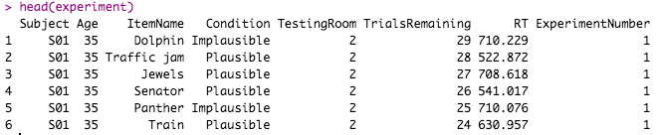
Mutate
We can use mutate() to create new columns in our dataframe:
experiment %>% mutate(ExperimentNumber = 1) -> experiment
Notes:
Log(1) = 0
Log(2) = 0.69
Log(3) = 1.10

Slide 21
Mutate
A more interesting example is where the assigned value is based on a formula
experiment %>% mutate(RTinSeconds = RT/1000) -> experiment
For each row, finds the RT in seconds for that specific trial and saves that into RTinSeconds
Similar to an Excel formula
If we wanted to alter the original RT column, we could instead do: mutate(RT = RT/1000)
Notes:
Log(1) = 0
Log(2) = 0.69
Log(3) = 1.10

Slide 22
Mutate
We can even use other functions in calculating new columns
experiment %>% mutate(logRT = log(RT)) -> experiment
Applies the logarithmic transformation to each RT and saves that as logRT
Notes:
Log(1) = 0
Log(2) = 0.69
Log(3) = 1.10

Slide 23
Week 2.2: Data Processing in R
Filtering
Basic Filtering
Advanced Filtering
Mutate
Basic Variable Creation and Editing
if_else()
Variable Types
Other Functions & Packages

Slide 24
if_else()
IF YOU WANT DESSERT, EAT YOUR PEAS
… OR ELSE!
Notes:
Log(1) = 0
Log(2) = 0.69
Log(3) = 1.10

Slide 25
if_else()
if_else(): A function that uses a test to decide which of two values to assign:
experiment %>% mutate( Half= if_else( TrialsRemaining >= 15, 1, 2) ) -> experiment
A new column called “Half”--what value are we going to assign ?
Function name
If 15 or more trials remain…
“Half” is 1
If NOT, “Half” is 2
Notes:
Log(1) = 0
Log(2) = 0.69
Log(3) = 1.10

Slide 26
Which do you like better?
experiment %>% mutate( Half=if_else(TrialsRemaining >= 15, 1, 2)) -> experiment
vs:
TrialsPerSubject <- 30
experiment %>% mutate( Half=if_else(TrialsRemaining >= TrialsPerSubject / 2, 1, 2)) -> experiment
Notes:
Log(1) = 0
Log(2) = 0.69
Log(3) = 1.10

Slide 27
Which do you like better?
experiment %>% mutate( Half=if_else(TrialsRemaining >= 15, 1, 2)) -> experiment
vs:
TrialsPerSubject <- 30
experiment %>% mutate( Half=if_else(TrialsRemaining >= TrialsPerSubject / 2, 1, 2)) -> experiment
Explains where the 15 comes from—helpful if we come back to this script later
We can also refer to CriticalTrialsPerSubject variable later in the script & this ensure it’s consistent
Easy to update if we change the number of trials
Notes:
Log(1) = 0
Log(2) = 0.69
Log(3) = 1.10

Slide 28
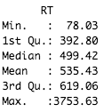
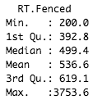
if_else()
Instead of comparing to specific numbers (like 15), we can use other columns or a formula:
experiment %>% mutate( RT.Fenced = if_else(RT < 200, 200, RT)) -> experiment
What is this doing?
Notes:
Log(1) = 0
Log(2) = 0.69
Log(3) = 1.10

Slide 29
if_else()
Instead of comparing to specific numbers (like 15), we can use other columns or a formula:
experiment %>% mutate( RT.Fenced = if_else(RT < 200, 200, RT)) -> experiment
Creates an RT.Fenced column where:
Where RTs are less than 200 ms, replace them with 200
Otherwise, use the original RT value
i.e., replace all RTs less than 200 ms with the value 200
Notes:
Log(1) = 0
Log(2) = 0.69
Log(3) = 1.10

Slide 30
if_else()
Instead of comparing to specific numbers (like 15), we can use other columns or a formula:
experiment %>% mutate( RT.Fenced = if_else(RT < 200, 200, RT)) -> experiment
For even more complex rescoring, use case_when()
Notes:
Log(1) = 0
Log(2) = 0.69
Log(3) = 1.10

Slide 31
Week 2.2: Data Processing in R
Filtering
Basic Filtering
Advanced Filtering
Mutate
Basic Variable Creation and Editing
if_else()
Variable Types
Other Functions & Packages

Slide 32
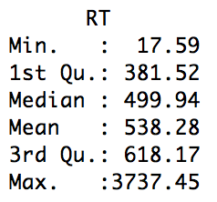
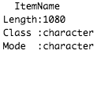
Types
R treats continuous & categorical variables differently:
These are different data types:
Numeric
Character: Freely entered text (e.g., open response question)
Factor: Variable w/ fixed set of categories (e.g., treatment vs. placebo)
Notes:
Log(1) = 0
Log(2) = 0.69
Log(3) = 1.10

Slide 33
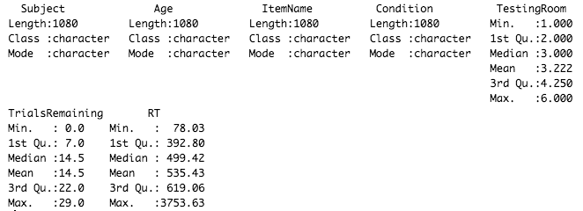
Types
R’s current heuristic when reading in data:
No letters, purely numbers → numeric
Letters anywhere in the column → character
Notes:
Log(1) = 0
Log(2) = 0.69
Log(3) = 1.10

Slide 34
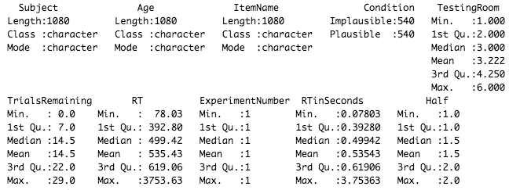
Types: as.factor()
For variables with a fixed set of categories, we may want to convert to factor
experiment %>% mutate(Condition=as.factor(Condition)) -> experiment
Notes:
Log(1) = 0
Log(2) = 0.69
Log(3) = 1.10

Slide 35
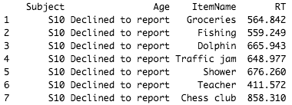
Types: as.numeric()
Age was read as a character variable because some people “Declined to report”
But, we may want to treat it as numeric despite this
Notes:
One thing to watch out for

Slide 36
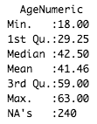
Types: as.numeric()
Age was read as a character variable because some people “Declined to report”
experiment %>% mutate(AgeNumeric=as.numeric(Age)) -> experiment
We now get quantitative information on Age
Values that couldn’t be turned into numbers are listed as NA
NA means missing data--we’ll discuss that more later in the term
Notes:
One thing to watch out for

Slide 37
Week 2.2: Data Processing in R
Filtering
Basic Filtering
Advanced Filtering
Mutate
Basic Variable Creation and Editing
if_else()
Variable Types
Other Functions & Packages

Slide 38
Other Functions
Some built-in analyses:
aov() ANOVA
lm() Linear regression
glm() Generalized linear models (e.g., logistic)
cor.test() Correlation
t.test() t-test
Notes:
Log(1) = 0
Log(2) = 0.69
Log(3) = 1.10

Slide 39
Other Packages
Some other relevant packages:
lavaan Latent variable analysis and structural equation modeling
psych Psychometrics (scale construction, etc.)
party Random forests
stringr Working with character variables
lme4: Package for linear mixed-effects models
Get this one for next week
Notes:
Stringr – followup from last week

Slide 40
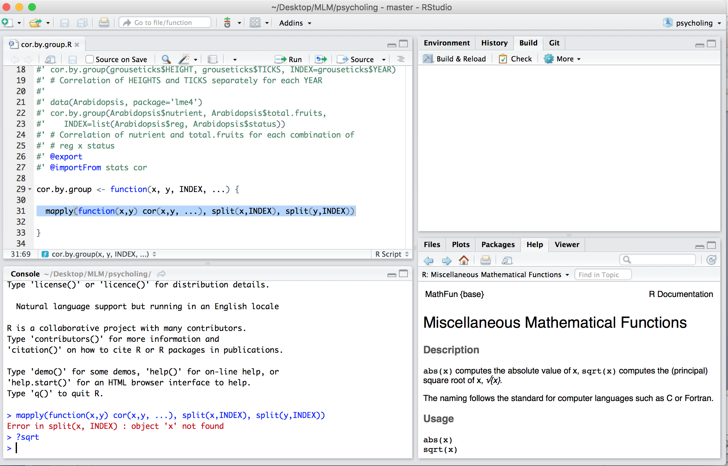
Getting Help
Get help on a specific known function:
?t.test
Lists all arguments
Try to find a function on a particular topic:
??logarithm
Notes:
Log(1) = 0
Log(2) = 0.69
Log(3) = 1.10

